Slide 2
Rushing wind blow through this temple
Blowing out the dust within
Come and breath Your breath upon me
I’ve been born again
Rushing Wind
CCLI Song # 372799
Keith Green
© Sony/ATV Music Publishing LLC
CCLI License # 538502

Slide 3
Holy Spirit, I surrender
Take me where You want to go
Plant me by Your Living Water
Plant me deep, so I can grow

Slide 4
Jesus, You’re the One
Who set my spirit free
Use me Lord, glorify
Your holy name thru me

Slide 5
Separate me from this world Lord
Sanctify my life for You
Daily change me to Your image
Help me bear good fruit

Slide 6
Every day You’re drawing closer
Trials come to test my faith
But when all is said and done Lord
You know it’s been worth the wait

Slide 7
Jesus, You’re the One
Who set my spirit free
Use me Lord, glorify
Your holy name thru me

Slide 9
Cherry Grove Friends Church
Today’s Date: __________________
Name: ________________________________________________
Address: ______________________________________________
City, State, Zip: _________________________________________
Phone: ________________________ Cell: ___________________
E-mail: ________________________________________________
r
Please see back for comments and prayer requests
Age Group: rCollege r20s r 30s r 40s r50s r60+
I am a r visitor-1st 2nd 3rd time more r Regular attender r Member
My Decision Today!
rI prayed to receive Christ
rI’m renewing my commitment to Christ
rI’m interested in Membership
rI’d like to talk to the pastor
r I’d like more information about...
Family Information
Name Present Birthdate
_____________ r _____________
_____________ r _____________
_____________ r _____________
_____________ r _____________
_____________ r _____________
_____________ r _____________
_____________ r _____________
_____________ r _____________
r Small groups r Youth group r children’s programs
r Missions and Outreach r Other
Thank you for registering your attendance with us today!
Notes:
Attendance

Slide 10

Children’s Church
This week the children will be studying 1 & 2nd Chronicles
with teacher Meta Mourton

Slide 12


Women’s Joy Bible Study
Genesis:
God’s Creative Call
Ladies meet in the Friendship Center
at 9:30am followed by
Sewing Circle Craft Time at 12:30pm

Slide 13
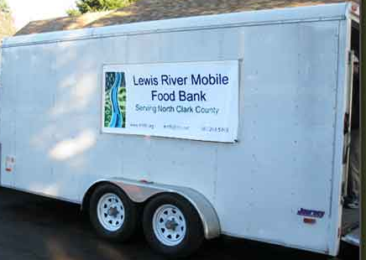
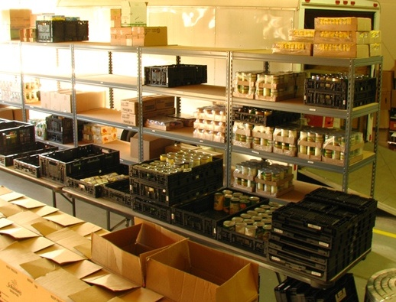
FOOD PANTRY NEEDS:
Protein rich foods; spaghetti, chili, stew
canned meat & fish
fruits & vegetables
Help us restock food bank shelves with your donations to our blessing barrel in the foyer

Slide 14


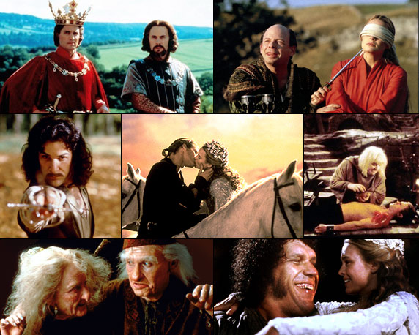
The Princess Bride
Saturday, November 21 at 6:30 pm

Slide 15

NEW!

Slide 17
He has shown thee, (echo)
O man, (echo)
What is good, and what the Lord requires of thee;
Micah 6:8
CCLI Song # 38710
Bob Skiar
© 1978, 1980 CCCM Music (Admin. by Brentwood-Benson Music Publishing, Inc.)
Universal Music - Brentwood Benson Publishing (Admin. by Brentwood-Benson Music Publishing, Inc.)
CCLI License # 538502

Slide 18
He has shown thee, (echo)
O man, (echo)
What is good, and what the Lord requires of thee;

Slide 19
But to do justly, (echo)
And to love mercy (echo)
And to walk humbly with thy God

Slide 20
But to do justly, (echo)
And to love mercy (echo)
And to walk humbly with thy God

Slide 21
He has shown thee, (echo)
O man, (echo)
What is good, and what the Lord requires of thee;

Slide 22
He has shown thee, (echo)
O man, (echo)
What is good, and what the Lord requires of thee;

Slide 23
But to do justly, (echo)
And to love mercy (echo)
And to walk humbly with thy God

Slide 24
But to do justly, (echo)
And to love mercy (echo)
And to walk humbly with thy God

Slide 26
This is my cry,
This is my song
You are my guiding light,
When the way is unknown
Jesus Lead On
CCLI Song # 2035848
Brent Helming
© 1996 Mercy / Vineyard Publishing (Admin. by Vineyard Music USA)
CCLI License # 538502

Slide 27
And when these sunny skies,
Turn shades of gray
I’ll stay close by Your side
As You lead the way

Slide 28
Jesus lead on, I will follow
Jesus lead on, let Your love light the way
Jesus lead on, I will follow
Jesus lead on

Slide 29
Hear now this cry
Hear now this song
You are the guiding light,
For this journey I’m on

Slide 30
And when my vision is clouded,
By the wind and the rain
I’ll stay close by Your side,
As You lead the way

Slide 31
Jesus lead on, I will follow
Jesus lead on, let Your love light the way
Jesus lead on, I will follow
Jesus lead on

Slide 32
Jesus lead on, I will follow
Jesus lead on, let Your love light the way
Jesus lead on, I will follow
Jesus lead on

Slide 33
Jesus lead on
Jesus lead on
Jesus lead on
Jesus lead on

Slide 35
God forgave my sins, in Jesus’ name
I’ve been born again, in Jesus’ name
And in Jesus’ name, I come to you
To share His love as He told me to
Freely Freely
CCLI Song # 13209
Carol Owens
© 1972 Bud John Songs, Inc. (Admin. by Capitol CMG Publishing)
CCLI License # 538502

Slide 36
He said, “Freely, freely, you have received
Freely, freely give
Go in My name and because you believe,
Others will know that I live”

Slide 37
All power is given, in Jesus name
On Earth and Heaven, in Jesus name
And in Jesus name, I come to you,
To share His power as He told me to

Slide 38
He said, “Freely, freely, you have received
Freely, freely give
Go in My name and because you believe,
Others will know that I live”

Slide 39
He said, “Freely, freely, you have received
Freely, freely give
Go in My name and because you believe,
Others will know that I live”

Slide 41
Ev’ry promise we can make
Ev’ry prayer and step of faith
Ev’ry difference we will make
Is only by His grace
Grace Alone
CCLI Song # 2335524
Jeff Nelson | Scott Wesley Brown
© 1998 Universal Music - Brentwood Benson Publishing (Admin. by Brentwood-Benson Music Publishing, Inc.)
CCLI License # 538502

Slide 42
Ev'ry mountain we will climb
Ev'ry ray of hope we shine
Ev'ry blessing left behind
Is only by His grace

Slide 43
Grace alone which God supplies
Strength unknown He will provide
Christ in us our Cornerstone
We will go forth in grace alone

Slide 44
Ev'ry soul we long to reach
Ev'ry heart we hope to teach
Ev'rywhere we share His peace
Is only by His grace

Slide 45
Ev'ry loving word we say
Ev'ry tear we wipe away
Ev'ry sorrow turned to praise
Is only by His grace

Slide 46
Grace alone which God supplies
Strength unknown He will provide
Christ in us our Cornerstone
We will go forth in grace alone

Slide 47
Grace alone which God supplies
Strength unknown He will provide
Christ in us our Cornerstone
We will go forth in grace alone
We will go forth in grace alone

Slide 49

ALL CHILDREN
Ages 3 years - Grade
MAY BE EXCUSED TO THEIR CLASS

Slide 51
Teach me to stop and listen
Teach me to center down
Teach me the use of silence
Teach me where peace is found
CCLI Song # 457449
Ken Medema
© 1978 Word Music, LLC (a div. of Word Music Group, Inc.)
CCLI License # 538502

Slide 52
Teach me to hear You calling
Teach me to search Your Word
Teach me to hear in silence
Things I have never heard

Slide 53
Teach me to be collected
Teach me to be in tune
Teach me to be directed
Silence will end so soon

Slide 54
Then when it's time for moving
Grant it that I may bring
To every day and moment
Peace from a silent spring

Slide 56
Mark 9:33-34
They came to Capernaum. When he was in the house, he asked them, "What were you arguing about on the road?" But they kept quiet because on the way they had argued about who was the greatest.

Slide 57
Mark 9:35
Sitting down, Jesus called the Twelve and said, "If anyone wants to be first, he must be the very last, and the servant of all."

Slide 58
Mark 9:36-37
He took a little child and had him stand among them. Taking him in his arms, he said to them, "Whoever welcomes one of these little children in my name welcomes me; and whoever welcomes me does not welcome me but the one who sent me."

Slide 59
Mark 9:38-40
"Teacher," said John, "we saw a man driving out demons in your name and we told him to stop, because he was not one of us." "Do not stop him," Jesus said. "No one who does a miracle in my name can in the next moment say anything bad about me, for whoever is not against us is for us.

Slide 60
Mark 9:41
“I tell you the truth, anyone who gives you a cup of water in my name because you belong to Christ will certainly not lose his reward.”

Slide 61
Mark 9:42
"And if anyone causes one of these little ones who believe in me to sin, it would be better for him to be thrown into the sea with a large millstone tied around his neck.

Slide 62
Mark 9:43-45
If your hand causes you to sin, cut it off. It is better for you to enter life maimed than with two hands to go into hell, where the fire never goes out. And if your foot causes you to sin, cut it off. It is better for you to enter life crippled than to have two feet and be thrown into hell.

Slide 63
Mark 9:46-48a
And if your eye causes you to sin, pluck it out. It is better for you to enter the kingdom of God with one eye than to have two eyes and be thrown into hell, where "'their worm does not die, and the fire is not quenched.'

Slide 64
Mark 9:48b-50
Everyone will be salted with fire. "Salt is good, but if it loses its saltiness, how can you make it salty again? Have salt in yourselves, and be at peace with each other."

Slide 65
Following the One Who Serves
Mark 9:33-37
Main Idea: Jesus shows his follower/cross-bearers how to be with and for others.

Slide 66
Following the One Who Serves
Treating everyone the same

Slide 67
Following the One Who Serves
Treating everyone the same
Taking life & others seriously enough to invest in persons and avoid their harm

Slide 68
Following the One Who Serves
Treating everyone the same
Taking life & others seriously enough to invest in persons and avoid their harm
Continuing a searching and fearless moral inventory of ourselves

Slide 69
Mark 9:33-34
They came to Capernaum. When he was in the house, he asked them, "What were you arguing about on the road?" But they kept quiet because on the way they had argued about who was the greatest.

Slide 70
Mark 9:35
Sitting down, Jesus called the Twelve and said, "If anyone wants to be first, he must be the very last, and the servant of all."

Slide 71
Mark 9:36-37
He took a little child and had him stand among them. Taking him in his arms, he said to them, "Whoever welcomes one of these little children in my name welcomes me; and whoever welcomes me does not welcome me but the one who sent me."

Slide 72
Mark 9:38-40
"Teacher," said John, "we saw a man driving out demons in your name and we told him to stop, because he was not one of us." "Do not stop him," Jesus said. "No one who does a miracle in my name can in the next moment say anything bad about me, for whoever is not against us is for us.

Slide 73
Mark 9:41
“I tell you the truth, anyone who gives you a cup of water in my name because you belong to Christ will certainly not lose his reward.”

Slide 74
Mark 9:42
"And if anyone causes one of these little ones who believe in me to sin, it would be better for him to be thrown into the sea with a large millstone tied around his neck.

Slide 75
Mark 9:43-45
If your hand causes you to sin, cut it off. It is better for you to enter life maimed than with two hands to go into hell, where the fire never goes out. And if your foot causes you to sin, cut it off. It is better for you to enter life crippled than to have two feet and be thrown into hell.

Slide 76
Mark 9:46-48a
And if your eye causes you to sin, pluck it out. It is better for you to enter the kingdom of God with one eye than to have two eyes and be thrown into hell, where "'their worm does not die, and the fire is not quenched.'

Slide 77
Mark 9:48b-50
Everyone will be salted with fire. "Salt is good, but if it loses its saltiness, how can you make it salty again? Have salt in yourselves, and be at peace with each other."

Slide 78
Following the One Who Serves
Treating everyone the same
Taking life & others seriously enough to invest in persons and avoid their harm
Continuing a searching and fearless moral inventory of ourselves

Slide 80
Will you come and follow me
If I but call your name?
Will you go where you don’t know
And never be the same?
Will you let my love be shown,
Will you let my name be known,
Will you let my life be grown
In you and you in me?
The Summons Song
CCLI Song #
John L. Bell
© 1987, Iona Community, GIA Publications, Inc. agent
CCLI License # 538502

Slide 81
Will you leave yourself behind
If I but call your name?
Will you care for cruel and kind
And never be the same?
Will you risk the hostile stare
Should your life attract or scare?
Will you let me answer pray’r
In you and you in me?

Slide 82
Will you let the blinded see
If I but call your name?
Will you set the pris’ners free
And never be the same?
Will you kiss the leper clean,
And do such as this unseen,
And admit to what I mean
In you and you in me?

Slide 83
Will you love the ‘you’ you hide
If I but call your name?
Will you quell the fear inside
And never be the same?
Will you use the faith you’ve found
To reshape the world around,
Through my sight and touch and sound
In you and you in me?

Slide 84
Lord, your summons echoes true
When you but call my name.
Let me turn and follow you
And never be the same.
In your company I’ll go
Where your love and footsteps show.
Thus I’ll move and live and grow
In you and you in me.

